Slide 1
Summary Of Research
Paper By:
Kasil Teyene , H.Taconi

Slide 2
Design and Implementation of a Low-Power
RISC-V Processor Core for Energy-Constrained Edge Devices
The paper deals with the entire design and implementation of low power methods on Risc v processor. A processor of a device is generally choosen due to its speed or we can also say performance but now we are seeing a exponential scale efficient computing and to perform well within Limited – Energy constraints.
The abstract for the Teyene & Taconi paper reports one clear headline number — a 43% energy-efficiency improvement over conventional RISC-V cores, achieved through fine-grain clock gating, power gating, and instruction-level parallelism on a 5-stage RV32IM(C) pipeline.

Slide 3
Motivation & Problem Statement
The Challenge
Edge devices (IoT, wearables, sensors) demand low power consumption but conventional processor architectures prioritize performance over efficiency, making them unsuitable for battery-powered or energy-harvesting devices.
The Solution
Develop a modular, energy-aware RISC-V processor core using:
Fine-grain clock gating
Power gating
Instruction-level parallelism
DVFS (Dynamic Voltage/Frequency Scaling)

Slide 4
RISC-V Architecture Overview
Why RISC-V for Edge Computing?
Open-source & license-free Modular instruction set Minimal core (RV321) with optional extensions (M, A, F/D, C) Supports custom extensions for domain-specific optimization Flexible for application-specific processors
Proposed Core Features:
RV32IMC + Custom extensions
5-Stage Pipeline
Hardware-level optimizations:
Clock gating on ALU, cache, register file
Power gating for idle blocks
DVFS hooks for external control
Energy-aware sleep/wake instructions
25-50 MHz clock frequency

Slide 5
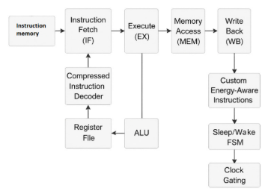
System Architecture
The processor core under this work is an RISC-V-based low-power processor core architecture that is based on the standard architecture of five-stage pipeline, which is divided into the following parts: Instruction Fetch (IF), Instruction Decode (ID), Execute (EX), Memory Access (MEM), and Write Back (WB). This pipelining scheme supports higher instruction throughput at the same time as supporting simplicity and area efficiency, essential to edge devices with restricted hardware capabilities

Slide 6
System Architecture
This set of architectural elements provides a trade-off between
performance, power efficiency and configurability, and
hence it is suitable to next-generation edge computing
systems where energy-constrained computing has to be performed
The architecture also includes custom extensions to ISA in order to be more energy-efficient specifically in low-power use.
These contain special instructions to enter and leave
low-power sleep states, which allow dynamically Managing instruction through software.

Slide 7
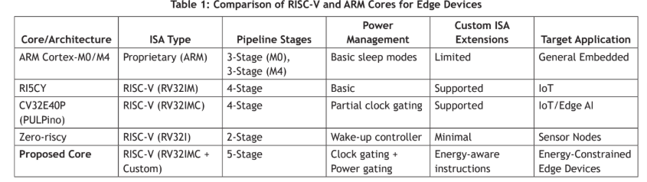
Table Explanation

Slide 8
This table compares five processor cores on how well-suited each is for low-power edge/IoT devices, across five dimensions. Here's what each column and row is telling you:
The columns (evaluation criteria):
ISA Type — whether the core uses a proprietary instruction set (ARM) or an open RISC-V variant, and which extensions it supports (I = base integer, M = multiply/divide, C = compressed instructions)
Pipeline Stages — how many steps an instruction passes through before completing; more stages generally means more throughput but more hardware (and power) to manage
Power Management — what hardware techniques the core uses to cut power when idle
Custom ISA Extensions — whether the design can add its own special instructions (useful for things like triggering sleep modes directly from software)
Target Application — what kind of device the core was designed for

Slide 9
Our Coustamized processor — positioned as the most complete design: RV32I with M, C, and custom extensions, a full 5-stage pipeline (matching or exceeding the others in capability), and — critically — both clock gating and power gating together, plus custom "energy-aware instructions" that let software explicitly tell the hardware when to enter low-power states.

Slide 10
Results
What the paper actually reports and what these charts show:
Energy chart — the paper's central claim: the proposed core (fine-grain clock gating + power gating + instruction-level parallelism, on a 5-stage RV32IM/C pipeline) uses about 43% less energy than a conventional RISC-V core doing comparable work, with similar functional performance.
Pipeline chart — pulled from your uploaded table: it shows where the proposed core sits architecturally relative to the others. Notably, it's the deepest pipeline (5 stages, matching more capability) while still claiming the biggest efficiency win — the paper's argument is that smart gating recovers the power cost of that extra pipeline depth.

Slide 11
